Slide 1

C# Programming Language Fundamentals

Slide 2
Prerequisites
Computer and its basic knowledge.
Integrated Development Environment or Code Editor
Visual Studio (Recommended)
Visual Studio Code

Slide 3
Overview
Introduction
Our First C# program
.NET Overview?
IDE – Visual Studio quick tour
C# syntax
Variables and Data Types
Type Conversions
Conditionals
Loops
Classes
Object Oriented Programming
Value Types vs Reference Types
Compilation and CLR
Assemblies and Referencing
Exceptional Handling

Slide 4










Web
Microsoft
Open Source
Cross Platform
Desktop
Cloud
Object Oriented Programming
IoT
Mobile
Type Safety
Automatic Memory Management
Games
AI
Exceptional Handling

Slide 5
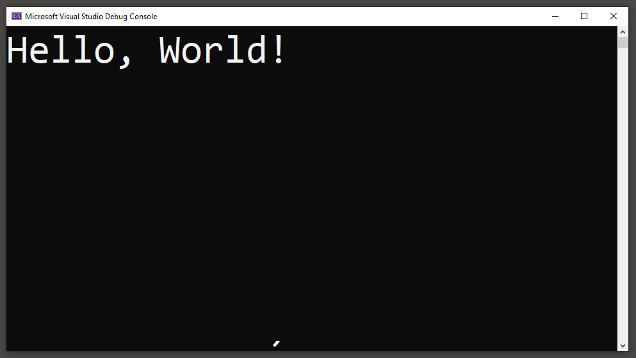
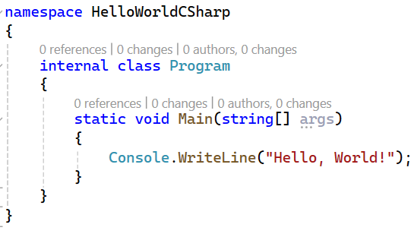
Our First C# Program
RUN
Console Application --name Hello World

Slide 6
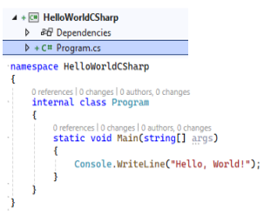


C# Source Code Execution
Common Language Runtime is a program which converts MSIL code into machine understandable native code.
(010101010)
C# Source Code
C# Compiler
(Roslyn)
MSIL Code
(.dll or .exe)
CLR
Just In Time
Compiler
Compiler is a C# program which converts C# source code into Microsoft Intermediate Language (MSIL) code as a .dll or .exe
Console Application
|--------------------- Compilation Process -----------------------|
|--------------------- Runtime Process -----------------------|

Slide 7
CIL Code
(.dll or .exe)
CLR
for Windows
C# Source Code
HelloWorldCSharp
C# Compiler
(Roslyn)
VB.NET Source Code
HelloWorldVB
VB Compiler
(Roslyn)
CLR
for MacOS
F# Source Code
HelloWorldFSharp
F# Compiler
CLR
for Linux OS
New# Source Code
HelloWorldNewSharp
New# Compiler
Common Type System (CTS)
Common Language Specification (CLS)
|--------------------- Compilation Process -----------------------|
|--------------------- Runtime Process -----------------------|

Slide 8
.NET Ecosystem and its tools
Application Models
Web Apps
(ASP.NET CORE
MVC, Web APIs, Razor Pages)
Base Class Libraries
Desktop Apps
(WPF, Win forms)
Visual Studio IDE / VS Code
Common Language Runtime (CLR)
Mobile Apps
(Android, IOS)
Compilers for C#, VB F#
Programming Languages C#, VB, F#
MAUI

Slide 9
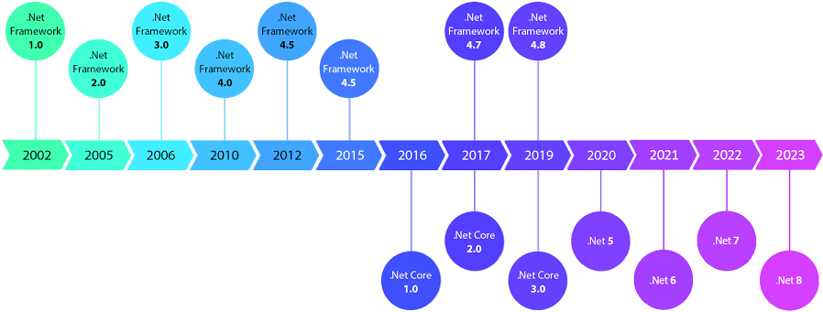

Slide 10
Version History
Target | Version | C# language version default
.NET | 8.x | C# 12
.NET | 7.x | C# 11
.NET | 6.x | C# 10
.NET | 5.x | C# 9.0
.NET Core | 3.x | C# 8.0
.NET Core | 2.x | C# 7.3
.NET Standard | 2.1 | C# 8.0
.NET Standard | 2 | C# 7.3
.NET Standard | 1.x | C# 7.3
.NET Framework | all | C# 7.3

Slide 11
C# Assembly
MS SQL Server Database
Class
Class
Table
Table
Table
Class
Class
Class
Table
Table
Table
Class
Class
Class
Table
Table
Table
Class
Class
Class
Table
Table
Table
Class
Class
Class
Table
Table
Table
Class
Class
Class

Slide 12
C# Assembly
MS SQL Server Database
namespace: MyApp.User
Schema: dbo User
Class
Class
Class
Table
Table
Table
Class
Class
Class
Table
Table
Table
namespace: MyApp.Admin
Schema: Admin
Table
Table
Table
Class
Class
Class
Table
Table
Table
Class
Class
Class

Slide 13
Keywords
abstract | delegate | if | override | struct | volatile
as | do | implicit | params | switch | while
base | double | in | private | this
bool | else | int | protected | throw
break | enum | interface | public | true
byte | event | internal | readonly | try
case | explicit | is | ref | typeof
catch | extern | lock | return | uint
char | false | long | sbyte | ulong
checked | finally | namespace | sealed | unchecked
class | fixed | new | short | unsafe
const | float | null | sizeof | ushort
continue | for | object | stackalloc | using
decimal | foreach | operator | static | virtual
default | goto | out | string | void

Slide 14
Contextual Keywords
add | group | record
and | init | remove
alias | into | required
ascending | join | scoped
args | let | select
async | managed | set
await | nameof | unmanaged
by | nint | value
descending | not | var
dynamic | notnull | when
equals | nuint | where
File | on | with
from | or | yield
get | orderby
global | partial

Slide 15
C# Data Types
Value Types
Reference Types
Built-in
User defined
User defined
Built-in
integer
float
double
decimal
bool
enum
struct
string
object
class
interface
delegate

Slide 16
Data Types
Data Type | Size |  | Description
Integer
sbyte | 8 bits |  | -2⁷ to 2⁷-1
int | 32 bits |  | -2³¹ to 2³¹-1 (-2,147,483,648 to 2,147,483,647)
short | 16 bits |  | -2¹⁵ to 2¹⁵-1
long | 64 bits |  | -2⁶³ to 2⁶³-1 (-9,223,372,036,854,775,808 to 9,223,372,036,854,775,807)
Real Or Floating Point
float | 32 bits | 32 bits | ±1.5 × 10⁻⁴⁵ to ±3.4 × 10³⁸ ⁽7 decimal digits). Suffix: f
double | 64 bits | 64 bits | ±5.0 × 10⁻³²⁴ to ±1.7 × 10³⁰⁸ (15 decimal digits). Suffix: D
decimal | 128 bits | 128 bits | ±1.0 × 10⁻²⁸ to ±7.9228 × 10²⁸. Suffix: M
bool | 1 bit | 1 bit | true or false
Free Text
char | 2 bytes | 2 bytes | ‘@’
string | 2 bytes per character | 2 bytes per character | “Hello”. Size = (2* no of characters in the sequence) bytes.

Slide 17
ADO.NET – Data Access API
“ADO.NET is a data access api in .NET Platform to interact with different data sources such as databases (sql server, oracle, etc.), xml, Microsoft access, and other in a standard, and structured approach.”

Slide 18
ADO.NET Architecture
Web Application
Desktop Application
Mobile Application
Web APIs
Other
Connection Oriented Architecture
.NET Data Provider
Disconnected Oriented Architecture
Dataset
Data Reader
Data Adaptor
Data Table
Data Table
Command
Data Row
Data Column
Data Column
Data Column
Data Column
Connection
Data Row
Data Row
Data Row
Constraints
Constraints
Microsoft Data Sql Client
System Data OLEDB
System Data Oracle Client
Data Table Relation
In-Memory representation of result set tables from SQL command execution
SQL SERVER
MY SQL
ORACLE

Slide 19
MS SQL SERVER Data Access
Add below DLL as project reference through manage NuGet package manager.
Microsoft.Data.SqlClient
System.Data.SqlClient (Legacy library)
SQL Server data provider provides the following classes to interact with database.
Class | Description
SqlConnection | Establishes a connection to a datsbase.
SqlCommand | Represents an individual SQL statement or stored procedure that can be executed against the database connected.
SqlDataReader | Provides read-only, forward-only access to the data in a database.
SqlDataAdaptor | Acts as a bridge between the command and connection objects and a dataset

Slide 20
SqlConnection
+ ConnectionString : string
+ Open ( ) : void + Close ( ) : void
UML Diagram
SqlDataReader
+ indexer : object
+ FieldCount : int
+ Read ( ) : bool + Close ( ) : void
SqlDataAdaptor
+ SelectCommand : SqlCommand
+ InsertCommand : SqlCommand
+ UpdateCommand : SqlCommand
+ DeleteCommand : SqlCommand
+ Fill ( ) : int + update ( ) : int
SqlCommand
+ Connection : SqlConnection
+ CommandType : Text or SP
+ CommandText : Query or SP
+ Parameters : SqlParameters[]
+ ExecuteNonQuery ( ) : int + ExecuteScalar ( ) : object + ExecuteReader ( ) : data reader

Slide 21
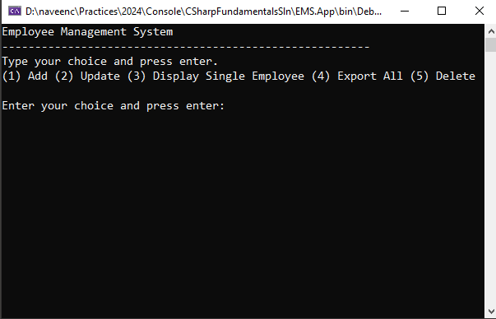

EMS Project v1

Slide 22
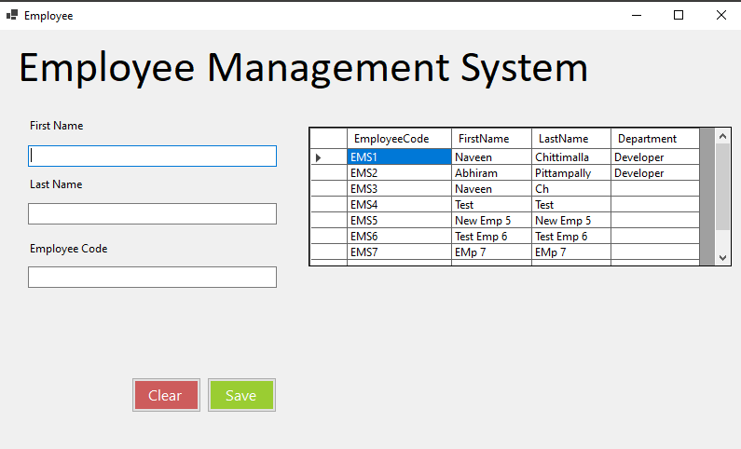
EMS Project v2
Scheduler
Recurring job to fetch all the employees from database and save them in a csv file and place the file at a specified location.

Slide 23
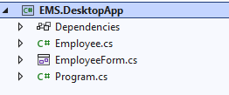

EMS Project v2 Solution 1
Scheduler
Recurring job to fetch all the employees from database and save them in a csv file and place the file at a specified location.

Slide 24

EMS Project v2 Solution 2
Scheduler
Recurring job to fetch all the employees from database and save them in a csv file and place the file at a specified location.

Slide 25
C# Assembly
Assembly is a collection of types such as namespaces, classes, interfaces, enums and resources that are built to work together and form a logical unit of functionality.
Assembly can be a DLL or EXE based on the project type template that we choose.
Class Library is a collection of classes and namespaces in C# without any entry point method like Main. Output Type is .dll
Console App is an application that takes input and displays output at a command line console and behaves as an app host to run .dll and which has an entry point method like Main. Output Type is .exe and .dll file
namespace: MyApp.User
Class
Class
Class
interface
struct
enum
namespace: MyApp.Admin
Class
Class
Class
interface
struct
enum

Slide 26
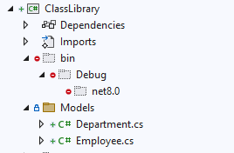
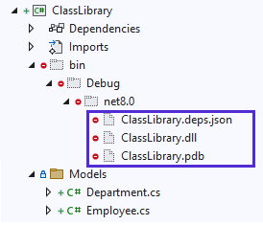
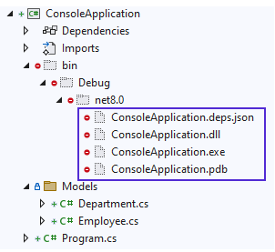
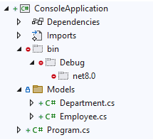
Class Library
.dll (Dynamic Link Library)
C# Compiler
Build the Class Library project, then C# compiler converts C# code into MSIL code and packages all the types into .dll file
Console Application
.exe (Executable)
C# Compiler
Build or Run the Console App project, then C# compiler converts C# code into MSIL code and generates .exe and .dll files

Slide 27
Let’s Write Code

Slide 28
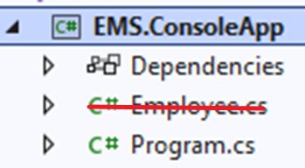
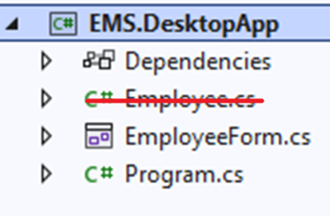
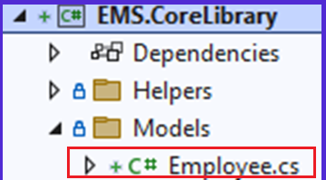
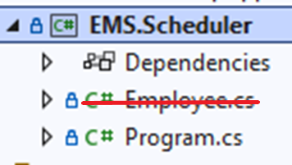
EMS Project v3
Database
…
https://ems.com
Web
Reactjs
Microsoft Data Sql Client
X
X
Mobile
X
Scheduler
Generate a csv file and place the file at a specified location.
Mobile
X
C# not compatible

Slide 29
What is API ?
“API stands for Application Programming interface, is a set of routines, protocols, and tools for building software applications and communicate with each other.”
Software Application
or
Component
Software Application
or
Component
API

Slide 30

What is Web APIs ?
“Web APIs are simply the APIs that communicate over the internet.”
Software Application
or
Component
Software Application
or
Component
API
Internet

Slide 31
EMS Project v3
…
https://ems.com
Web
Reactjs
API
Mobile
API which is accessible and understandable by all application
Scheduler
Generate a csv file and place the file at a specified location.
Mobile

Slide 32
What is Web APIs ?
Application Programming interface, is a set of routines, protocols, and tools for building software applications and communicate with each other.
Web APIs are simply the APIs that communicate over the internet.
Follows Client-Server model with request-response pattern
Software Application
or
Component
Software Application
or
Component
Request
Request
API
Response
Response
Internet

Slide 33
Web API
…
https://ems.com
Request
Database
Web
Reactjs
Response
Client
Server

Slide 34
HTTP
Hypertext Transfer Protocol (HTTP) is an application-layer protocol for transmitting hypermedia documents, such as HTML or data such as json, xml etc.
Follows Client-Server model with request-response pattern
Stateless protocol means that the server does not keep any data (state) between two requests. Simply, every request is a new request.
Client
Request
Server
Response
Browser
Mobile
…..
Web API
Internet

Slide 35
HTTP Request
HTTP Request is a message sent by client to communicate with server over internet.
HTTP Request consists of following elements.
Element | Description | Format
Request Line | Specifies HTTP Method, path, HTTP protocol version. | {HTTP Method} {Path} {HTTP Version}
Headers | Client to pass additional information about request to server. | Host User-agent Connection Accept Content-type
Empty Line | To separate body and other elements
Body | Client to pass data to server for few HTTP methods such as POST/PUT/PATCH | Json, xml, html, text etc.

Slide 36
HTTP Response
HTTP Response is a message sent by server to communicate with client over internet.
HTTP Response consists of following elements.
Element | Description | Format
Response Line | Specifies HTTP Method, path, HTTP protocol version. | {HTTP Version} {Status Code} {Status Text}
Headers | Server to pass additional information about response to client. | Date Server Connection Content-type
Empty Line | To separate body and other elements
Body | Not all responses have one: Responses with a status code that sufficiently answers the request without the need for corresponding payload (like 201 Created or 204 No Content) usually don't. | Json, xml, html, text etc.

Slide 37
HTTP GET Request-Response
Element | Request | Response
Request Line | GET /employees HTTP/1.1 | HTTP/1.1 200 OK
Headers | Host: api.employees.com User-Agent: Mozilla/4.0 Accept: application/json Content-Type: application/json | Server: IIS Date: Mon, 01 Jan 2024 Connection: Keep-Alive Content-Type: application/json
Empty Line
Body |  | { “id”: 1, “employeeCode”: “EMS0001” “firstName”: ”Naveen”, “lastName”: ”CH”, “email”: “naveen.ch@g.com”, “active”: true }

Slide 38
HTTP POST Request-Response
Element | Request | Response
Request Line | POST /employees HTTP/1.1 | HTTP/1,1 200 OK
Headers | Host: api.employees.com User-Agent: Mozilla/4.0 Accept: application/json Content-Type: application/json | Server: IIS Date: Thu, 09 May 2024 07:07:51 GMT Content-Type: application/json Location: http://localhost:5247/api/Employees/1
Empty Line
Body | { “firstName”: ”Naveen”, “lastName”: ”CH”, “email”: “naveen.ch@g.com”, “active”: true } | { “id”: 1, “employeeCode”: “EMS0001” “firstName”: ”Naveen”, “lastName”: ”CH”, “email”: “naveen.ch@g.com”, “active”: true }

Slide 39
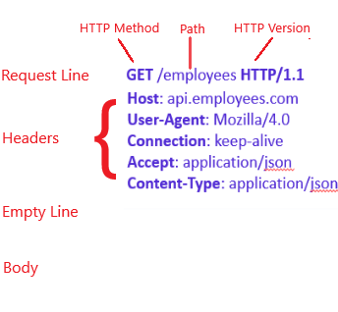
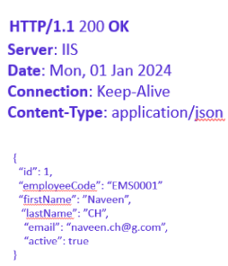
HTTP Request Response
Client
Server
Request
Response

Slide 40
HTTP Request Methods
HTTP defines a set of request methods to indicate the desired action to be performed for a given resource.
Request methods are sometimes referred to as HTTP verbs.
Request method can be safe, idempotent, or cacheable
Method | Action | Safe | Idempotent | Cacheable
GET | Retrieve a specified resource. Read-Only | YES | YES | YES
POST | Create a resource | NO | NO | NO
PUT | Update a specified resource | NO | YES | NO/{YES (Rare)}
DELETE | Delete a specified resource | NO | YES | NO/{YES (Rare)}
PATCH | Partial updates a specific resource | NO | YES | NO
Safe: Doesn't alter the state on the server. Simply it is a read-only operation.
Idempotent: intended effect on the server of making a single request is the same as the effect of making several identical requests, but response returned by each request may differ. Ex: first delete call will return 200 while successive ones will likely return 404.
Cacheable: HTTP Response data can be stored and used later, saving a new request to server.

Slide 41
HTTP Status Code Ranges
Code Range | Description
1xx (100-199) | Informational responses.
2xx (200-299) | Successful responses.
3xx (300-399) | Redirects
4xx (400-499) | Client errors
5xx (500-599) | Server errors
Note: If you receive a response that is not in this list, it is a non-standard response, which is custom to the server's software.

Slide 42
HTTP Status Codes
Code | Text | Description
200 | OK | The request has succeeded.
201 | Created | The request has succeeded, and a new resource has been created as a result.
204 | No Content | There is no content to send for this request.
301 | Moved Permanently | The URL of the requested resource has been changed permanently. The new URL is given in the response.
400 | Bad Request | The request has not processed due to invalid or incomplete data.
401 | Unauthorized | "unauthenticated". The client's identity is unknown
403 | Forbidden | “unauthorized”. The client's identity is known but does not have access rights to the content.
404 | Not Found | The requested resource not found
405 | Method Not Allowed | The method has been disabled and cannot be used.
406 | Not Acceptable | Content not supported.
408 | Request Timeout | Request Timeout
415 | Unsupported Media Type | The media format of the requested data is not supported
500 | Internal Server Error | The server has encountered a situation it doesn't know how to handle.

Slide 43
Thank You!

Slide 44
ApiController attribute
Attribute Routing Requirement: With ApiController, attribute routing becomes a requirement. This means you must use [Route], [HttpGet], [HttpPost], etc., to define the routes for your actions.
Automatic HTTP 400 Responses: It automatically handles model validation errors by providing a standardized response. If the request model does not satisfy the model validation rules, the API responds with a 400 Bad Request without writing additional code.
Binding Source Parameter: The attribute infers the source of parameters for actions. For instance, it assumes [FromBody] for complex type parameters and [FromQuery] for simple types in GET requests. This reduces the need to specify the source of the parameter explicitly.
Enhanced Swagger Support: When used in conjunction with tools like Swashbuckle, it provides better metadata for API documentation. This results in more descriptive Swagger UIs.

Slide 45
ControllerBase class
Designed for building Web APIs or RESTful services focusing on returning data (JSON, XML) rather than rendering HTML views.
It provides access to several properties and methods useful for handling HTTP requests, such as
Request
Response
ModelState
Various methods for returning data (Ok, NotFound, BadRequest, etc.).
It does not include support for views or rendering HTML.

Slide 46
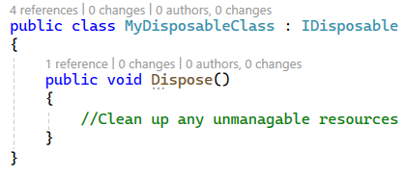
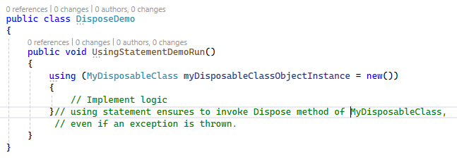
using statement
using block can be used on the objects or instances of the classes which inherits from IDisposable class and implements Dispose method.
using block does ensure that the object Dispose method will always be invoked, no matter if an exception is thrown or not.
Dispose is a method used to clean up resources. In the case of a DB connection, the connection is released or closed, which is important.
Note: The equivalent of using is a try finally, which includes a call to Dispose within the finally block.

Slide 47
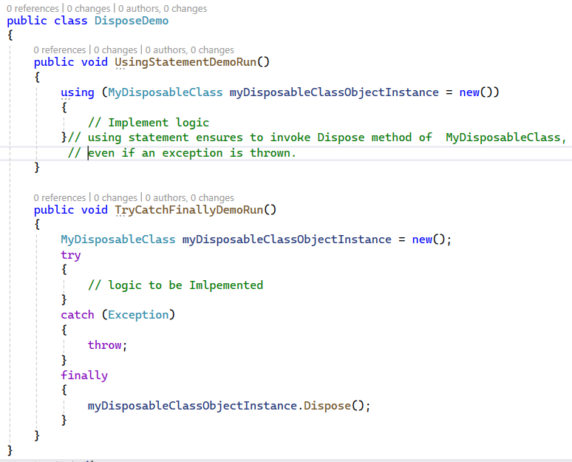
using statement

Slide 48
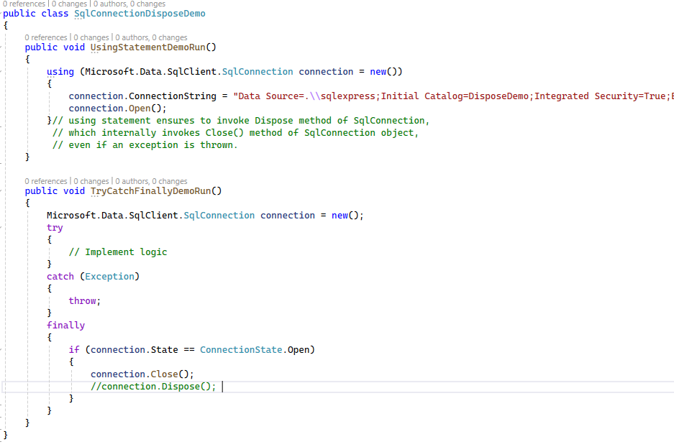
using statement example

Slide 49
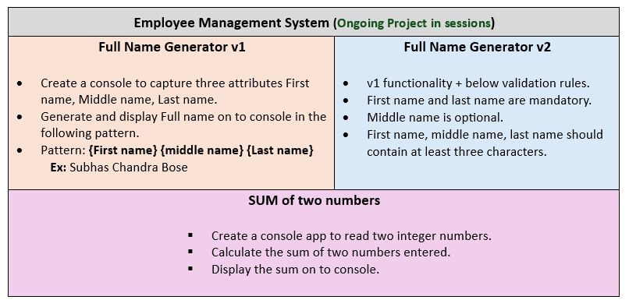
C# Project
Even or Odd Number Checker: Read a number and print if it is an even or odd number.
Print Even and Odd Numbers from a range between 1 to 100 separately.
Read range start and range end number. Print Even numbers in the given range.
Read a number and print a multiplication table of it.
Calculate the Sum, Multiplication, Division and Subtraction of Two Numbers

Slide 50
Web
Open Source
Desktop
Cross Platform
AI
Mobile
Object-Oriented Programming
IoT
Type Safety
Games
Exceptional Handling
Automatic Memory Management
Cloud

Slide 51
C#
Open Source
Cross Platform
Strongly Typed
Case Sensitive
Memory Management
Object Oriented
Usage
Desktop Applications
Web Applications
Mobile Applications
Cloud Applications
Web APIs
SSIS Packages
Many More…

Slide 52
Compilation and Runtime Execution
Language
CLR
JIT Compiler
Native Code
Compiler
IL Code
(DLL or EXE)
|-------------------- Compilation Process ------------------------|
|---------- Runtime Process ----------|

Slide 53
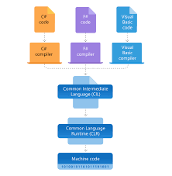
Architecture
Two major components of .NET ecosystem are
The Common Language Runtime (CLR) is the execution engine that handles running applications. It provides services like thread management, garbage collection, type-safety, exception handling, and more.
The Class Library provides a set of APIs and types for common functionality. It provides types for strings, dates, numbers, etc. The Class Library includes APIs for reading and writing files, connecting to databases, drawing, and more.
.NET applications are written in the C#, F#, or Visual Basic programming language. Code is compiled into a language-agnostic Common Intermediate Language (CIL). Compiled code is stored in assemblies—files with a .dll or .exe file extension.
When an app runs, the CLR takes the assembly and uses a just-in-time compiler (JIT) to turn it into machine code that can execute on the specific architecture of the computer it is running on.

Slide 54
STACK
HEAP

Slide 55
Assembly (.exe or .dll)
Basic building block of .NET applications.
Assembly is a collection of types and resources that are built to work together and form a logical unit of functionality.
Assemblies form the fundamental units of deployment, version control, reuse, activation scoping, and security permissions for .NET-based applications.
Assembly can be a DLL or EXE based on the project that we choose.

Slide 56
ADO.NET – Data Access API
“ADO.NET is a data access api in .NET Platform to interact with different data sources such as databases (sql server, oracle, etc.), xml, Microsoft access, and other in a standard, and structured approach.”

Slide 57
ADO.NET – Data Access API
“ADO.NET is a data access api in .NET Platform to interact with different data sources such as databases (sql server, oracle, etc.), xml, Microsoft access, and other in a standard, and structured approach.”

Slide 58
ADO.NET – Components
.NET Data Provider
Dataset
Data Table
Data Table
Connection
Data Column
Data Column
Data Column
Data Column
Command
Data Reader
Data Row
Data Row
Data Adaptor
Data Relations
Constraints
Data Relations
Constraints

Slide 59
ADO.NET – Data Access API
“ADO.NET is a data access api in .NET Platform to interact with different data sources such as databases (sql server, oracle, etc.), xml, Microsoft access, and other in a standard, and structured approach.”

Slide 60
Code
Assembly

Slide 61
Normal Template #512BD4
Normal Template #512BD4
Dotnet Deck Template #3A20A0
Dotnet Deck Template #3A20A0
Dotnet Deck Template Font #4826C0
Dotnet Deck Template Font #4826C0
C# Logo #2A0066
C# Logo #2A0066

